Slide 1
How to Ethically Generate Abundant Referrals to Your Practice:
Turning Google’s Updates into Your Best Referral Source
Joe Bavonese, PhD Roy Huggins, LPC, NCC Uncommon Practices Person Centered Tech
www.uncommonpractices.com www.personcenteredtech.com
www.uncommonpractices.com | www.personcenteredtech.com

Slide 2
Abundant Mobile Referrals
Searching for Therapists Online is Moving Rapidly Toward Mobile Devices
In Many Parts of the US, 50-60% of Searches for a Therapist Now Happen on an iPhone or Android phone
www.uncommonpractices.com | www.personcenteredtech.com

Slide 3
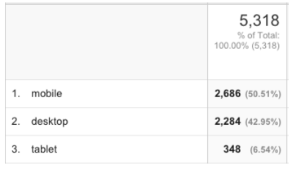
Abundant Mobile Referrals
Joe had 57% of Searches from Mobile Devices in January 2016
www.uncommonpractices.com | www.personcenteredtech.com

Slide 4
Abundant Mobile Referrals
Sales of Mobile Devices are Far Outselling Desktop and Laptop Computers – and this Mobile Revolution is Predicted to Continue to Expand in the Coming Years
www.uncommonpractices.com | www.personcenteredtech.com

Slide 5
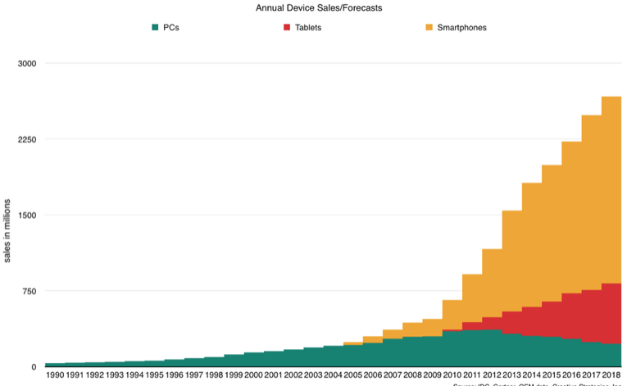
Abundant Mobile Referrals
www.uncommonpractices.com | www.personcenteredtech.com

Slide 6
Abundant Mobile Referrals
Bigger Screens, Faster Processors, 4G/LTE Faster Internet and Voice Input are the Factors Driving More Search on Smartphones
www.uncommonpractices.com | www.personcenteredtech.com

Slide 7
Abundant Mobile Referrals
Google is Making it More Difficult for Traditional SEO Best Practices to Work on Smartphones
www.uncommonpractices.com | www.personcenteredtech.com

Slide 8
Abundant Mobile Referrals
Google Has Reduced the Number of Free Business Listings on Page One – on both Desktop and Mobile - from 7 to 3
Google is Also Now Showing 3 Ads at the Top of the Mobile Search Screen, vs 2 in 2015
www.uncommonpractices.com | www.personcenteredtech.com

Slide 9
Abundant Mobile Referrals
These Changes by Consumers and Google Presents Challenges…but Also Opportunities for Private Practice Marketing
www.uncommonpractices.com | www.personcenteredtech.com

Slide 10
Abundant Mobile Referrals
Before Mobile, Internet Marketing Consisted of Getting a Profile or Website Found Online, and then Your Website Had the Job of Convincing Someone to Contact You
www.uncommonpractices.com | www.personcenteredtech.com

Slide 11
Abundant Mobile Referrals
Now WITH Mobile, People Searching for a Therapist are Holding an Instant Contact Device Right in Their Hands
www.uncommonpractices.com | www.personcenteredtech.com

Slide 12
Abundant Mobile Referrals
Texting, Email or Phone Calls are All Available with One Touch
Texting Can be Configured for Free Using Google Voice
www.uncommonpractices.com | www.personcenteredtech.com

Slide 13
Abundant Mobile Referrals
People May Prefer One over the Other Type of Communication – It’s Best to Offer ALL THREE to Potential Clients
www.uncommonpractices.com | www.personcenteredtech.com

Slide 14
Abundant Mobile Referrals
www.uncommonpractices.com | www.personcenteredtech.com

Slide 15
Ethics and HIPAA on Texting, Email and Initial Contact
Clients may contact you how they choose, but you must safeguard the messages that they send you
This may mean HIPAA Business Associate Agreements
Responding by text or email, without first informing the client of risks, may not be HIPAA compliant.
Responding by text or email, without a particular process, could also be unethical:
Definitely unethical under ACA Code of Ethics
Article: ACA 2014 Code of Ethics and Initial Contact
May be unethical under all other major codes
www.uncommonpractices.com | www.personcenteredtech.com

Slide 16
Solutions!
Phone calls are pretty much always A-OK
Enter… secure contact forms. Let’s see what that looks like:
Jane Therapist, Grad Dgr.: https://personcenteredtech.com/samplesite/
www.uncommonpractices.com | www.personcenteredtech.com

Slide 17
Abundant Mobile Referrals
But a Sample Search for a Therapist on an iPhone Reveals the Crux of the Challenges Facing Private Practitioners Today
www.uncommonpractices.com | www.personcenteredtech.com

Slide 18
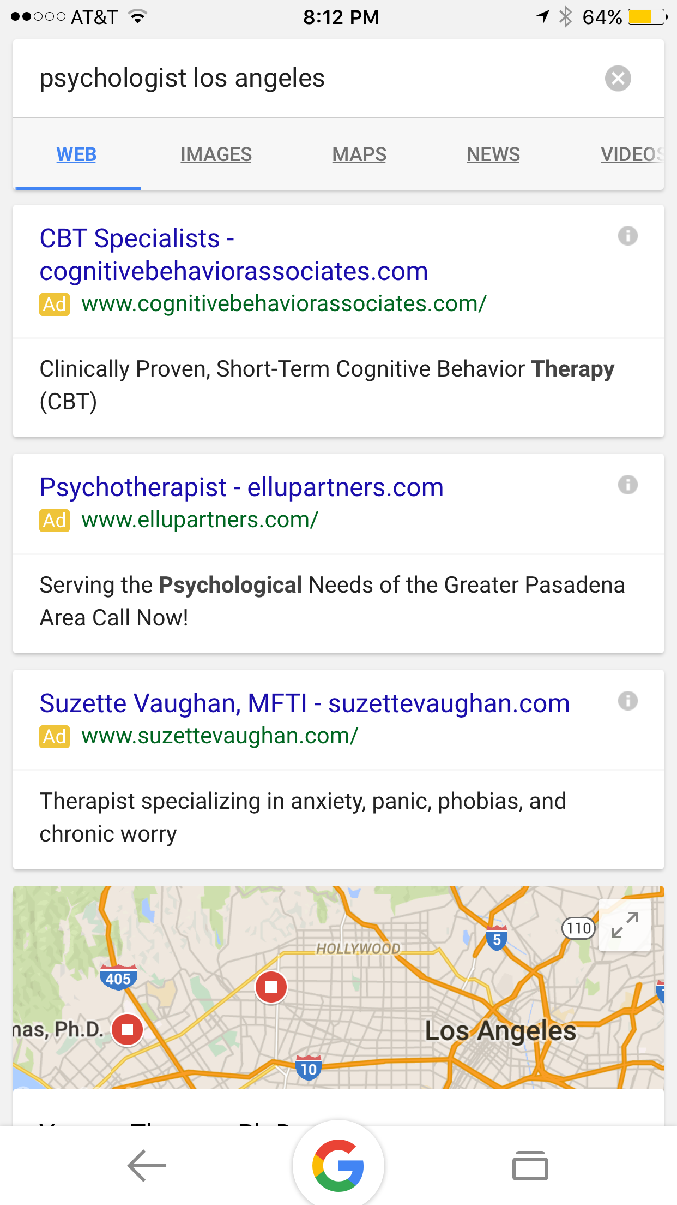
First Screen on a Google iPhone Search for a Psychologist in LA:
www.uncommonpractices.com | www.personcenteredtech.com

Slide 19
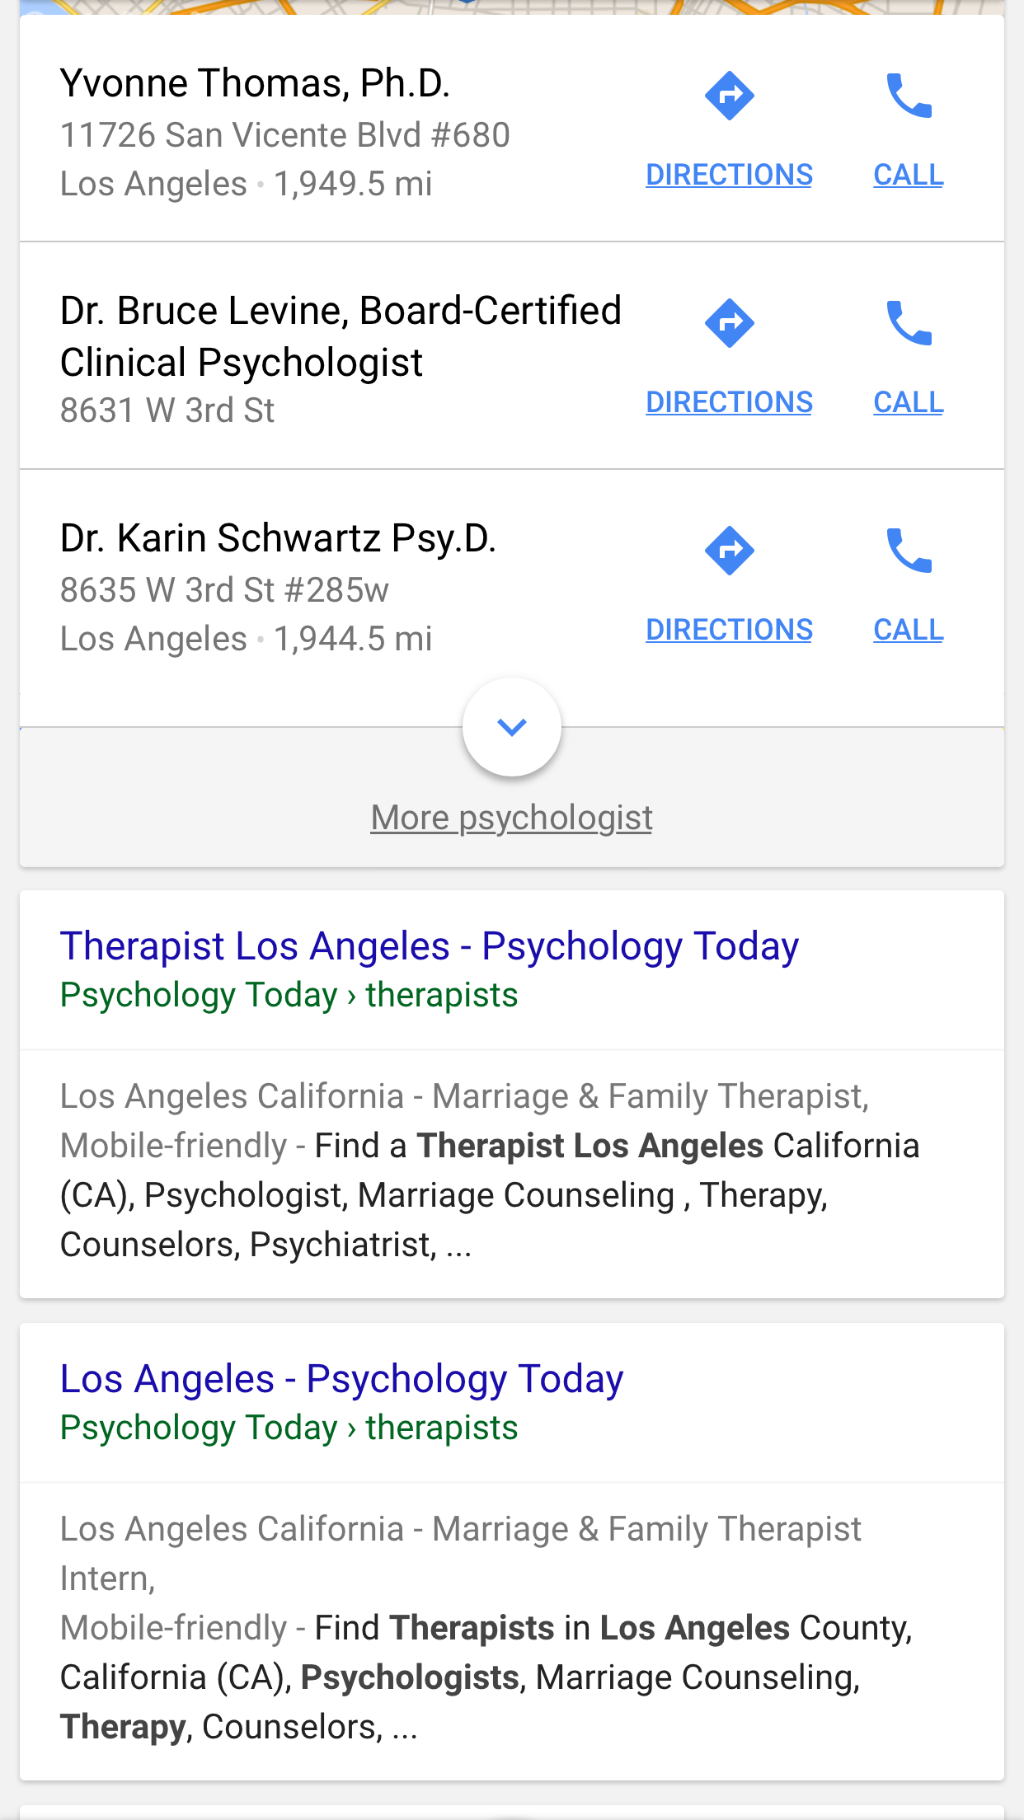
Second Screen on a Google iPhone Search for a Psychologist in LA:
www.uncommonpractices.com | www.personcenteredtech.com

Slide 20
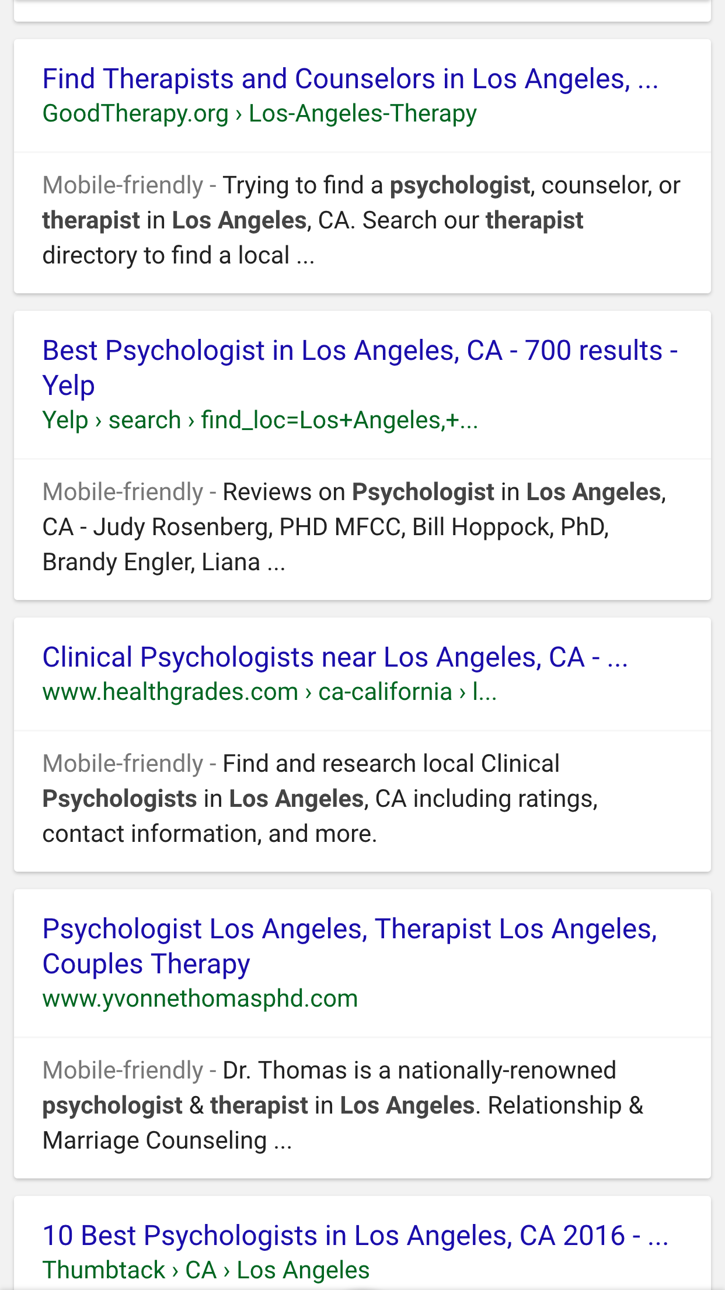
Third Screen on a Google iPhone Search for a Psychologist in LA:
www.uncommonpractices.com | www.personcenteredtech.com

Slide 21
Abundant Mobile Referrals
Ads and Directories DOMINATE the First THREE Screens
The Message is Clear: PAY TO PLAY
www.uncommonpractices.com | www.personcenteredtech.com

Slide 22
Abundant Mobile Referrals
So How do You Get Found on a Smartphone?
Google Gets 65% of Search on Computers, but 85% on Smartphones!
www.uncommonpractices.com | www.personcenteredtech.com

Slide 23
Abundant Mobile Referrals
Create a Free Business Profile on www.google.com/business
Fill out as Much Information as You Can, and Try to Get Colleague Reviews on Your Profile
www.uncommonpractices.com | www.personcenteredtech.com

Slide 24
Ethics and Business Listings
Most effective way to get your business listing high on the search results is to get reviews on your listing. But…
Reviews from clients are unethical for all major ethics codes
Article: Ethical Practice Marketing and Online Reviews
www.uncommonpractices.com | www.personcenteredtech.com

Slide 25
Solutions!
Reviews from colleagues, supervisors, and other non-clients who know your work
Ask them to:
Make clear their relationship to you
Be entirely truthful
Not review you on sites that state that only clients of the therapist may leave reviews (e.g. HealthGrades)
Not make new accounts on Google+ (or Yelp!, etc.) just to review you – this is not an ethical concern, but a technical one. If people create accounts just to review you, you may be penalized.
Article: Ethical Practice Marketing and Online Reviews
www.uncommonpractices.com | www.personcenteredtech.com

Slide 26
Abundant Mobile Referrals
If Google Gets 85% of Search, and SEO Does Not Work Well, You Need to Use Google AdWords – To Guarantee You Are on that First Screen
www.uncommonpractices.com | www.personcenteredtech.com

Slide 27
Abundant Mobile Referrals
Google AdWords Has a Call Extension AND a Call Only Campaign Option to Further Improve Your Chances of Getting a Phone Call
www.uncommonpractices.com | www.personcenteredtech.com

Slide 28
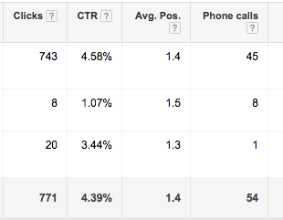
Abundant Mobile Referrals
Joe Phone Calls from Google AdWords, January 2016 (in addition to 26 texts and 34 emails)
www.uncommonpractices.com | www.personcenteredtech.com

Slide 29
Ethics and AdWords
It’s great. Go for it.
www.uncommonpractices.com | www.personcenteredtech.com

Slide 30
Abundant Mobile Referrals
Facebook is the Other Major Player in the Mobile Space
In the US, over 80% of Facebook Use is On Smartphones
Facebook Has the Longest Average Time of any Website
www.uncommonpractices.com | www.personcenteredtech.com

Slide 31
Abundant Mobile Referrals
Facebook, Like Google, Doesn’t Want to Promote Free Posts Promoting Your Practice
Ads Are Less Expensive Than Google’s, and Can Be Targeted Precisely to Your Ideal Client Profile
www.uncommonpractices.com | www.personcenteredtech.com

Slide 32
Ethics and Facebook Ads
Imagine an existing client seeing your ad show up in their Facebook feed
For most clients, risk of harm is low. However, the potential pitfall is worth considering before taking action.
www.uncommonpractices.com | www.personcenteredtech.com

Slide 33
Solutions!
A potential strategy: design ads to target needs and bring people to your site rather than to spread your brand.
Your clients won’t see you pop up in their feed if your ads don’t contain your profile picture, name, or business name writ large
Social media policies: let clients know ahead of time how you use social media to promote your practice when you do intake.
If you have a Facebook page, let them know how best to interact (or not interact) with it.
www.uncommonpractices.com | www.personcenteredtech.com

Slide 34
Abundant Mobile Referrals
SUMMARY: How to Take Advantage of the Mobile Revolution
www.uncommonpractices.com | www.personcenteredtech.com

Slide 35
Abundant Mobile Referrals
Use Directories such as Psychology Today and Good Therapy
Create Free Business Profile at www.google.com/business
www.uncommonpractices.com | www.personcenteredtech.com

Slide 36
Abundant Mobile Referrals
Use Google and Facebook Ads to get First Screen Attention on Smartphones
Be Sure Your Website is a Responsive Design on Mobile – and Allows ONE TOUCH CONTACT via Texting, Email or Phone
www.uncommonpractices.com | www.personcenteredtech.com

Slide 37
Abundant Mobile Referrals
Special Bonus ONLY For People on this Webinar
30% Discount on Creation of a NEW Google AdWords Campaign
www.uncommonpractices.com | www.personcenteredtech.com

Slide 38
Abundant Mobile Referrals
Go to http://uncommonpractices.com/payperclickpsy.html
Type in CLICK in the Coupon Code
www.uncommonpractices.com | www.personcenteredtech.com

